Slide 1
SOFTWARE ARCHITECTURE
BY: APEKSHA JADHAV
BAVITRA
CHARITHA G
PALLAVI
SOMYA

Slide 2
INTRODUCTION
Blueprint for a system
Establishes communication and coordination mechanism among system components
The principles guiding its design and evolution

Slide 3
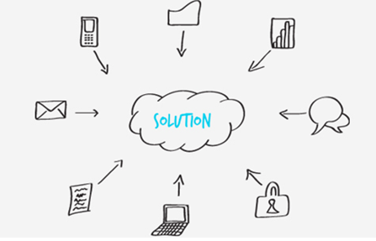
Why do we need it??????
World is increasingly dependant on software
Reduce system complexity
Distributing works to teams for developing components
Integrating components
Understanding “big picture” of the system

Slide 4


Slide 5
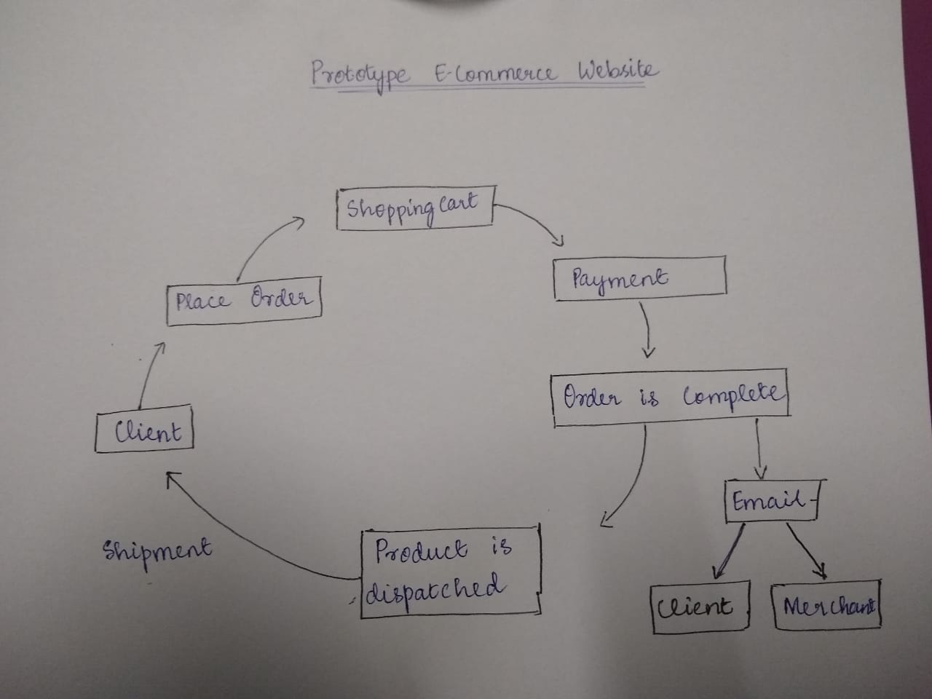
ARCHITECTURE OF AN E-COMMERCE SITE

Slide 6
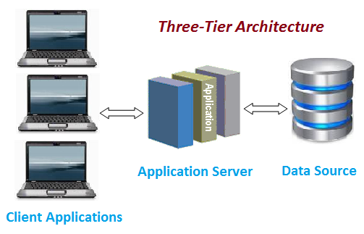
THREE-TIER ARCHITECTURE

Slide 7
QUALITY ATTRIBUTES
What are QUALITY ATTRIBUTES ?
- A quality attribute (QA) is a measurable or testable property of a system that is used to indicate how well the system satisfies the needs of its stakeholders.
- It is used as a measure to be free of all the defects and risks.
- Implementation of Quality Attributes differentiates a good system from a bad one.

Slide 8
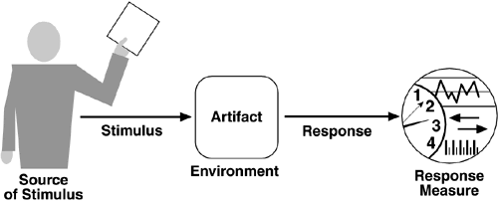
QUALITY SCENARIOS
Quality scenarios define how to prevent a failure. It is a set of that can be divided into 6 attributes.
- Source
- Stimulus
- Environment
- Artifact
- Response
- Response measure

Slide 9
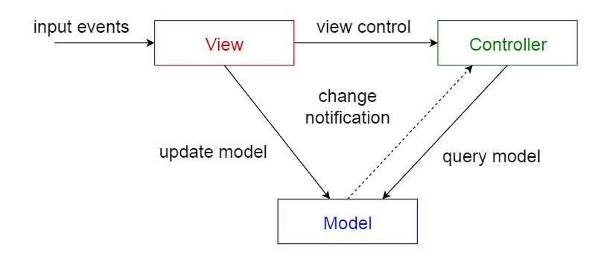
ARCHITECTURAL STYLES AND PATTERNS
Layered pattern
2. MVC
Presentation layer ( UI layer)
Business logic layer(domain layer)
Data access layer ( persistence layer)

Slide 10

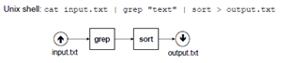


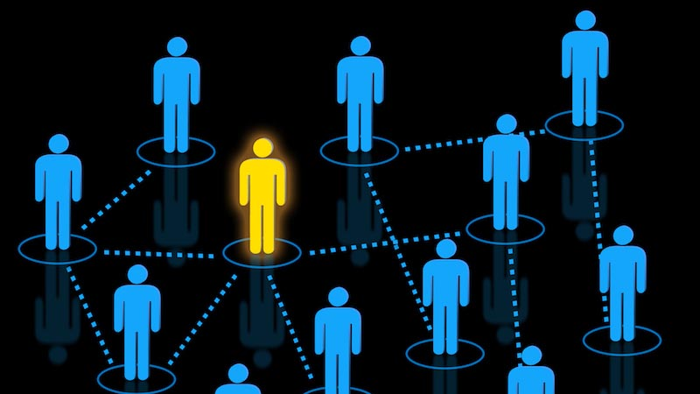
ARCHITECTURAL STYLES AND PATTERNS
3. Pipes and filters
4. Event-driven
6. Peer to peer
5. Client-server

Slide 11
Goals
Provide a personalized experience.
Make your website responsive.
Security
Privacy
Try to address the requirements of various stakeholders.

Slide 12
REFERENCES
https://en.wikipedia.org/wiki/Software_architecture
https://www.slideshare.net/dehringer/test-driven-development-5785229
https://youtu.be/N8NWDHgWA28
Architecture patterns:
https://www.youtube.com/watch?v=lTkL1oIMiaU
https://towardsdatascience.com/10-common-software-architectural-patterns-in-a-nutshell-a0b47a1e9013
https://www.youtube.com/channel/UCDhwJtVmUH3ezjKEZskXBBA/videos

Slide 13
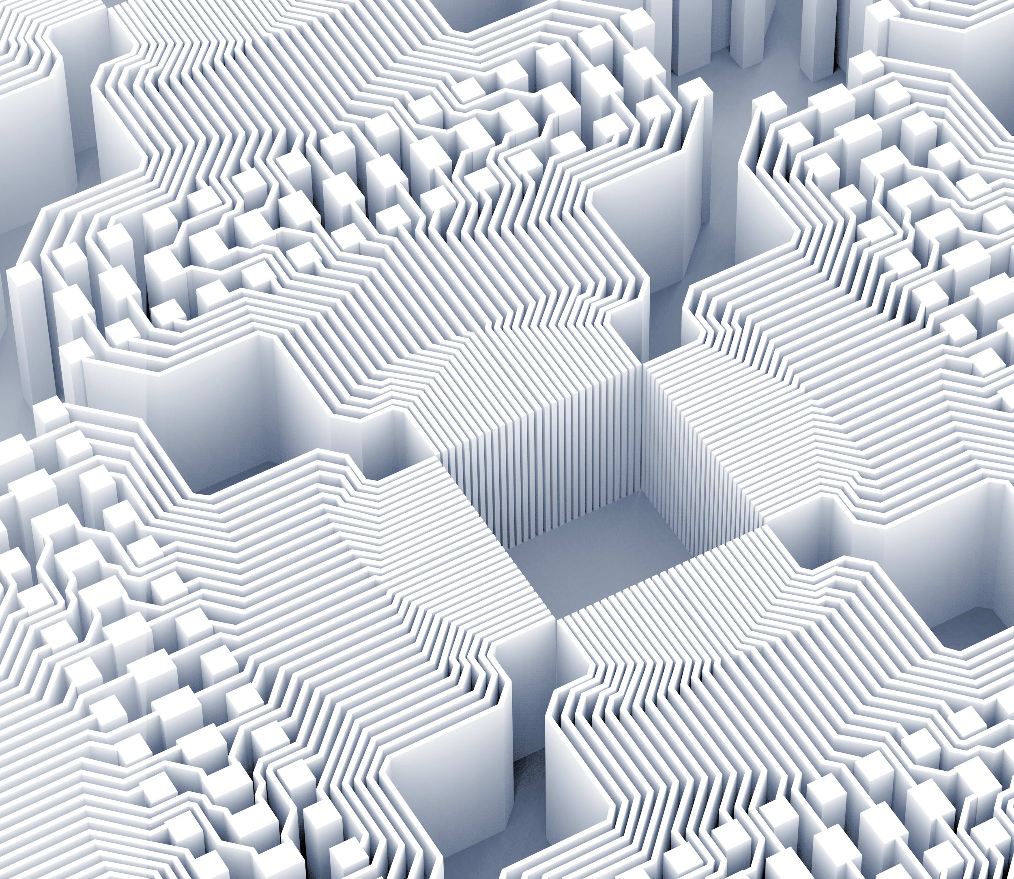
Thank you!

